Slide 1
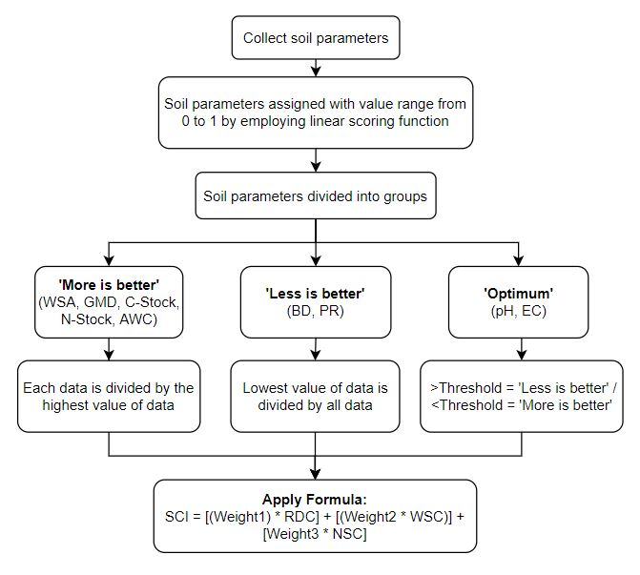
Weighted Additive SQI (SQI-2)
Abbreviations
WSA – Water Stable Aggregates
GMD – Geometric Mean Diameter
AWC – Available Water Capacity
BD – Bulk Density
PR – Penetration Resistance
EC – Electrical Conductivity
RDC – Root Development Capacity (BD, PR, WSA, GMD)
WSC – Water Storage Capacity (AWC)
NSC – Nutrient Supply Capacity (pH, EC, C-stock, N-stock)
Weight1/2/3 – numerical weights for each soil function (RDC, WSC, NSC)

Slide 2
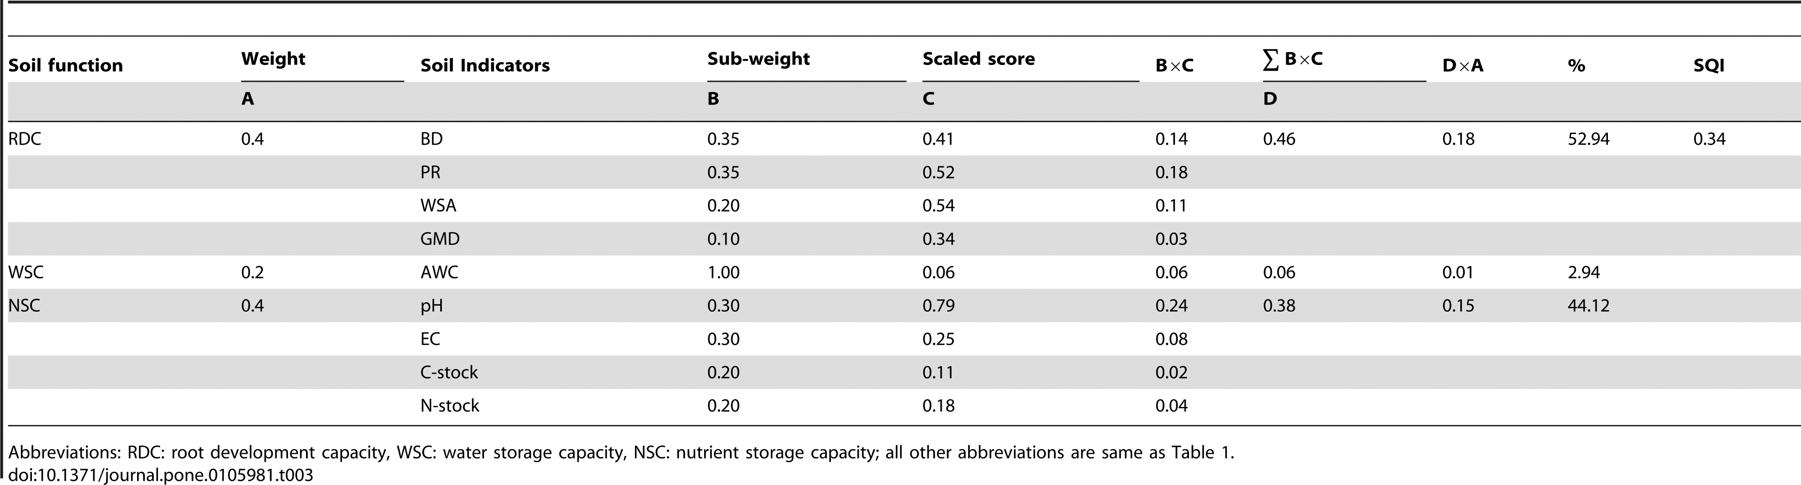
Rank
BD, PR
WSA, AWC, pH, EC
GMD, C-Stock, N-Stock
Weight is fixed
Sub-weight values based on their importance under the particular soil functional property (Rank stated above)
Ideal soil would have SQI value of 1 for the highest quality soil and 0 for the severely degraded soil

Slide 3
Use Cases of SQI
Formula | Values
SQI 1 | Evaluate soil quality
SQI 2 | Evaluate soil quality with high performance with more soil parameters
SQI 3 | Best method for long-term scenario, relative higher correlations with crop yield and lower number of indicator selection

